Slide 1
Real-time Chess with Socket.IO
Shamshadh Unissa
20951A05H1
Batch – 5

Slide 2
Abstract
To develop a real-time multiplayer chess game using Socket.IO, leveraging the power of JavaScript and web technologies. By implementing Socket.IO, players will experience synchronized gameplay, allowing multiple participants to make moves and see the actions of others in real time. This project provides an opportunity to gain expertise in web development, Socket.IO, real-time communication, and implementing complex game logic. The game will enforce the rules of chess, offer an intuitive user interface, and include additional features such as chat functionality and a timer. By building this project, I will develop practical skills in JavaScript, Socket.IO, game development, and creating immersive multiplayer experiences.

Slide 3
Problem Statement
Traditional turn-based chess games lack real-time interaction and can result in decreased engagement and excitement.
Existing online chess platforms do not provide real-time updates, requiring manual refreshing for gameplay updates.
The project aims to address these limitations by developing a real-time chess game using Socket.io, enhancing the gaming experience and enabling live interaction between players.

Slide 4
Existing System
Existing chess games or platforms lack real-time multiplayer functionality, synchronized gameplay, and features like chat or a timer, limiting the immersive multiplayer experience for chess enthusiasts.
Currently, most chess games follow a turn-based gameplay model.
Online chess platforms also lack real-time interaction and require manual refreshing for updates.
These limitations hinder the dynamic and immersive experience that real-time gaming offers.

Slide 5
Proposed System
Introduce the proposed solution of developing a real-time multiplayer chess game using Socket.IO. Highlight the benefits of Socket.IO in enabling real-time communication, bidirectional data exchange, and handling multiple simultaneous connections. Emphasize how the proposed system will address the limitations of existing systems, providing synchronized gameplay, enforcing turn-based mechanics, and offering additional features like chat and a timer.
Utilize Socket.io, a real-time communication library, to establish a seamless connection between players.
The multiplayer functionality enables players to create or join game rooms and play against each other.

Slide 6
Objectives
Develop a real-time multiplayer chess game using Socket.IO and JavaScript.
Provide synchronized gameplay for multiple players in real time.
Enhance the user interface with visual feedback and intuitive interactions.
Implement chat functionality for player communication during the game.
Include a timer to enforce time restrictions on each player's moves.
Gain practical skills in JavaScript, Socket.IO, game development, and creating immersive multiplayer experiences.

Slide 7
Methodology
Project follows an agile methodology for development, allowing iterative and flexible progress.
We utilize a technology stack that includes HTML, CSS, JavaScript, Node.js, Express.js, and Socket.io.
These technologies work together to create a real-time gaming experience and handle server-client communication.

Slide 8
Technologies Used
HTML: Provides the structure and markup of the web pages.
CSS: Used for styling and layout of the user interface.
JavaScript: Handles interactivity and functionality of the client-side application.
Node.js: Server-side JavaScript runtime environment.
Express.js: Web application framework for Node.js.
Socket.io: Real-time communication library for bidirectional server-client communication.

Slide 9
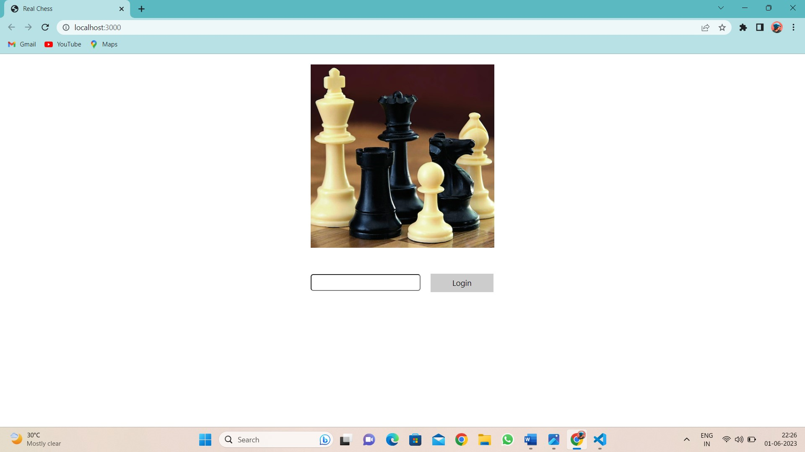
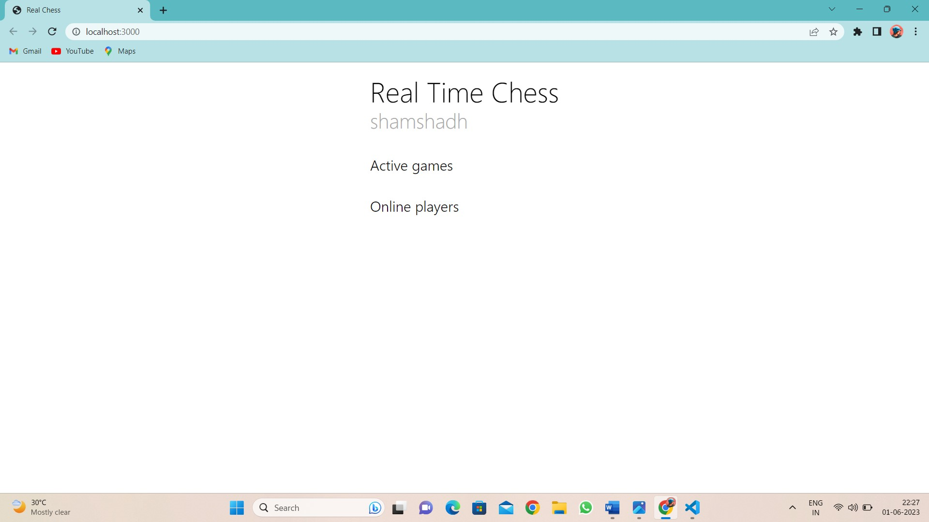
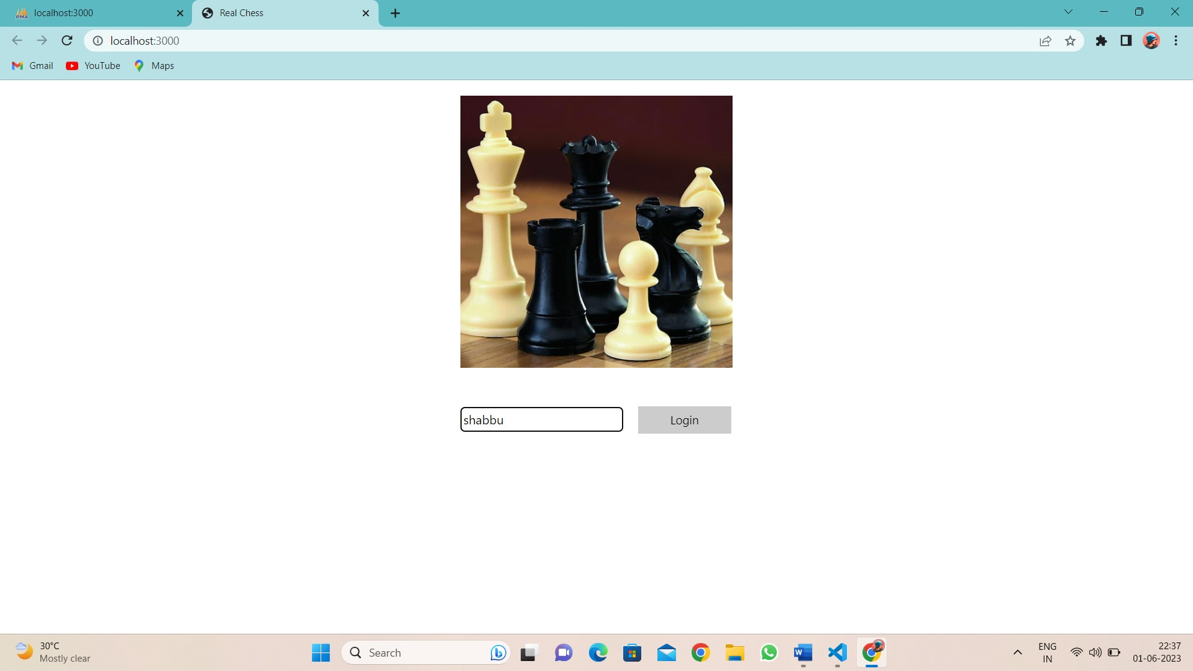
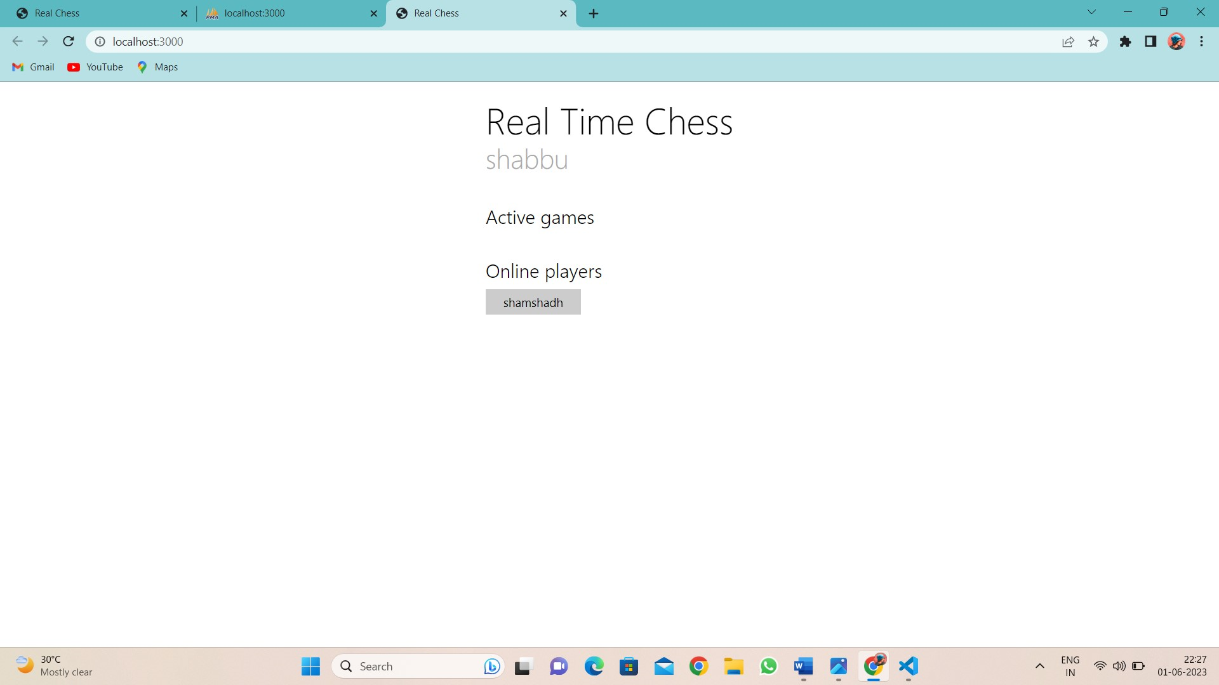

Slide 10
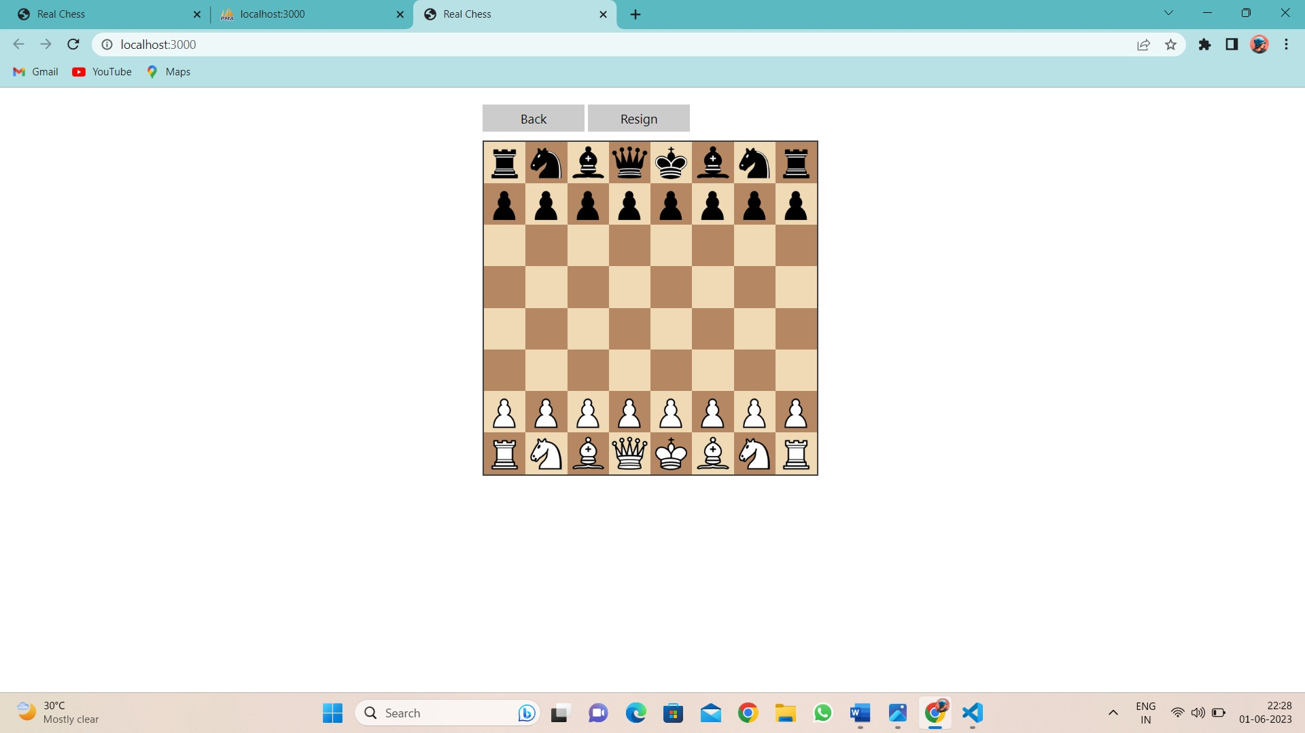
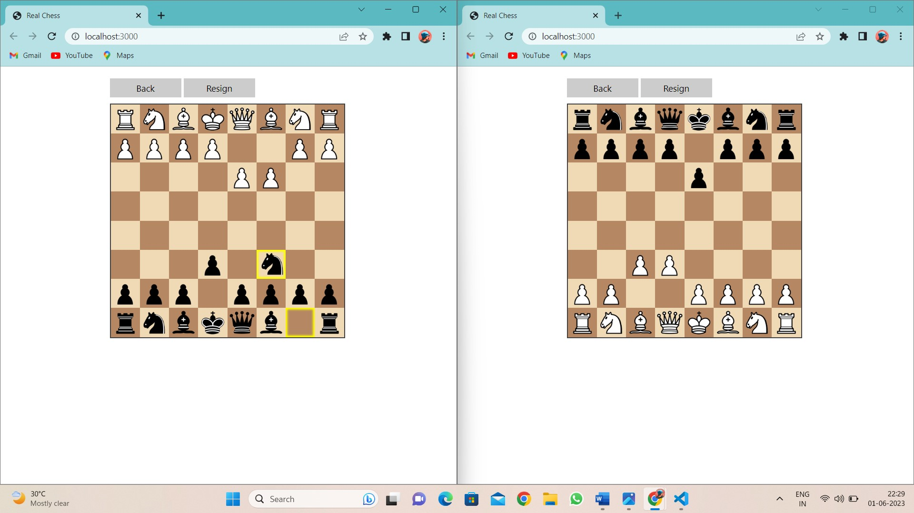
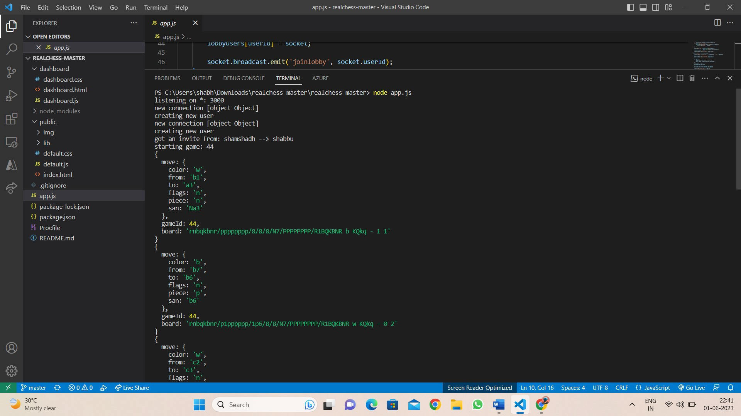
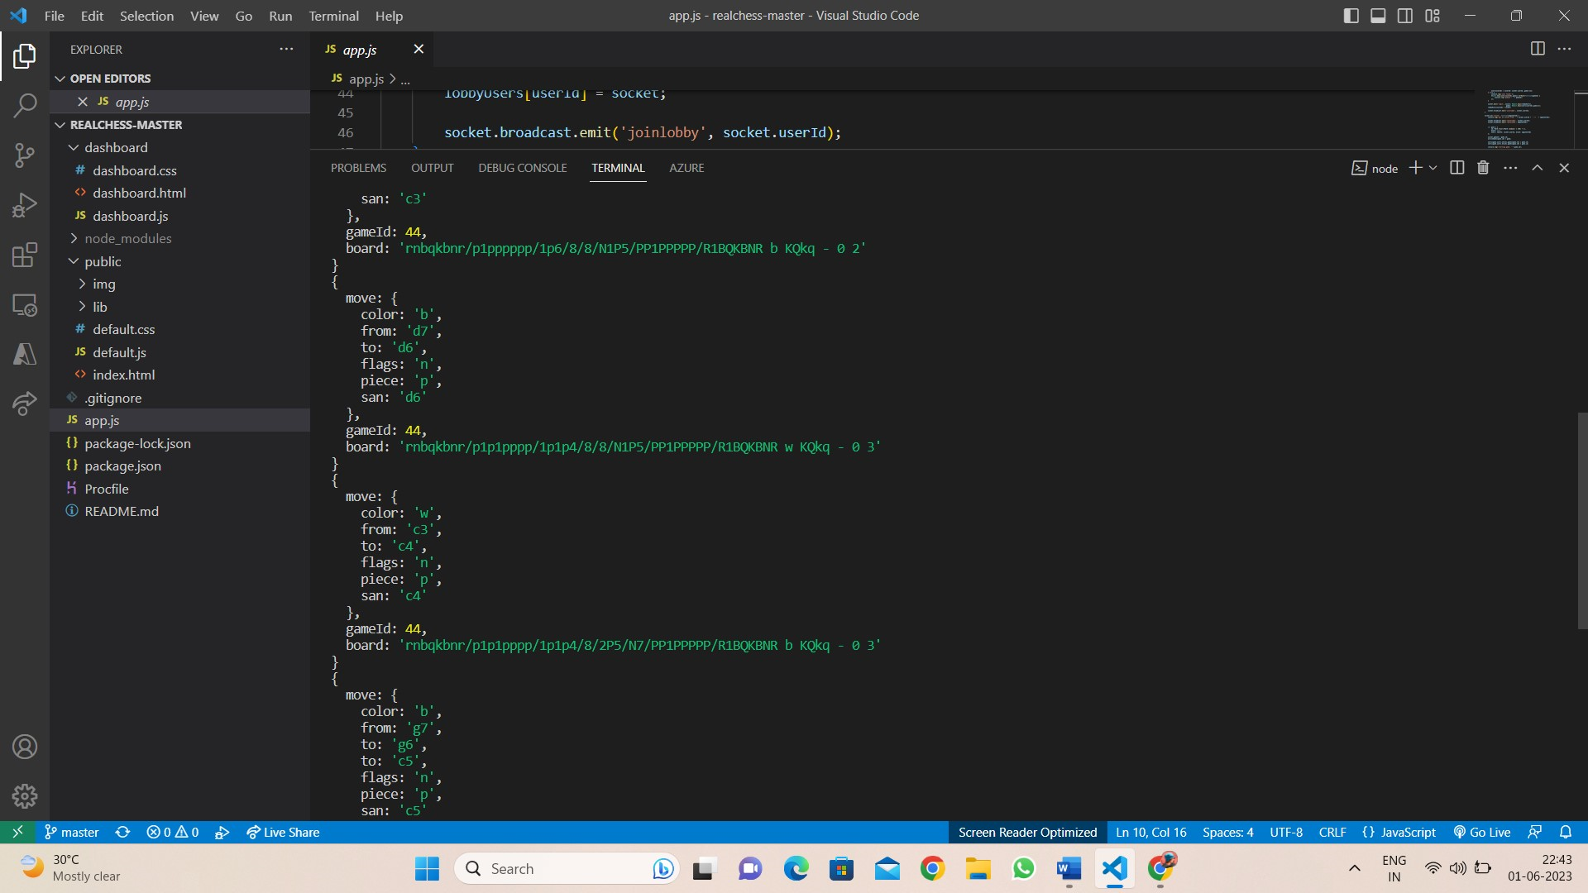

Slide 11
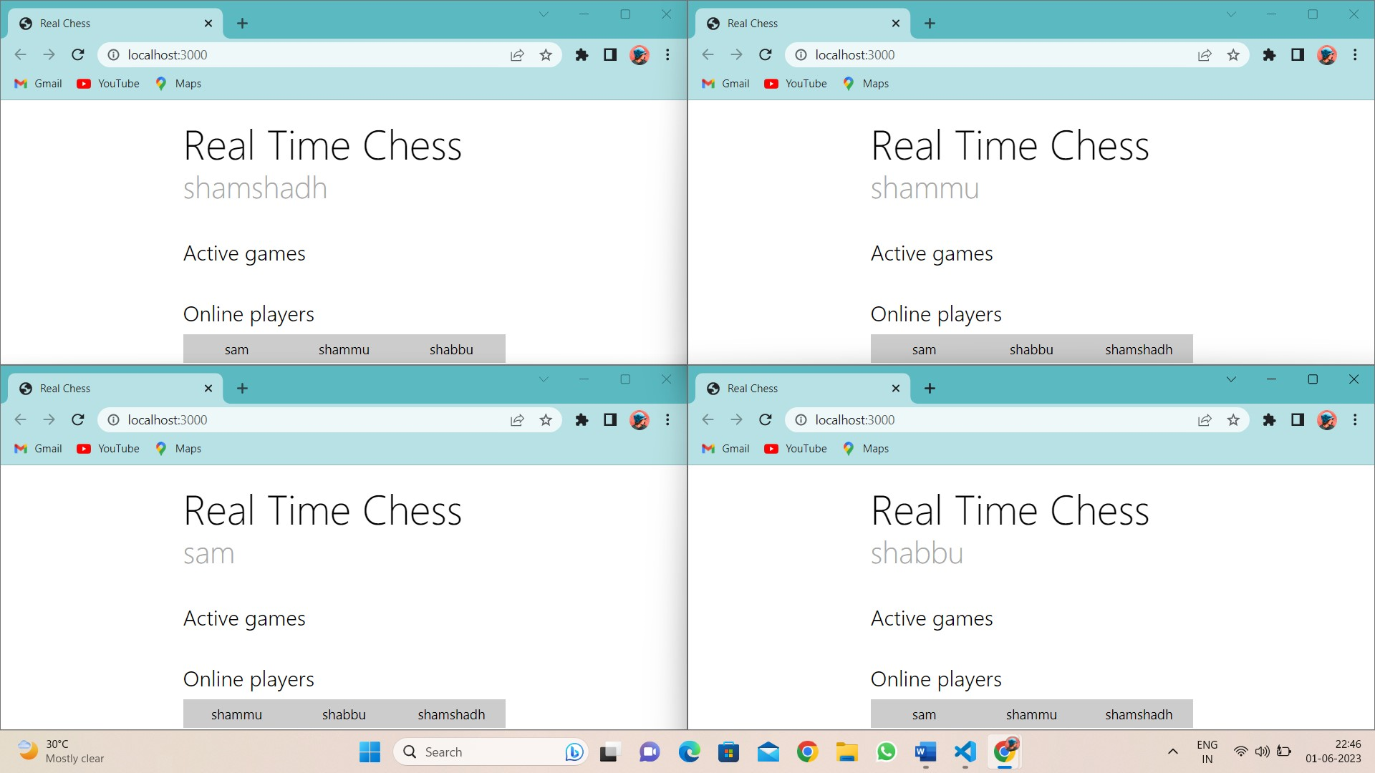

Slide 12
Conclusion
Real-time chess project offers an enhanced gaming experience with live gameplay and interaction. The utilization of Socket.io and the chosen technology stack enables seamless real-time communication. This project has the potential to revolutionize online chess gaming and provide players with a dynamic and engaging experience.

Slide 13
Thank You

